Slide 1
Understanding ANSI SQL
Joins and Their Types
LEVEL – LEARNER

Slide 2






Icons Used
Questions
Hands on Exercise
Test Your Understanding
Reference
Summary
Rule

Slide 3
Objectives
After this session you will be able to:
Understand JOIN & JOIN Style
Understand Theta Style
Understand ANSI Style: JOIN ... ON & JOIN ... USING
Understand CROSS JOIN
Understand INNER JOIN
Understand EQUI-JOIN
Understand NATURAL JOIN
Understand OUTER JOIN
Understand LEFT OUTER JOIN
Understand RIGHT OUTER JOIN
Understand FULL OUTER JOIN
Understand SELF JOIN

Slide 4
Case Study
For complete understanding of ANSI SQL we are going to make use of Product Management System (PMS) for ABC Traders.
ABC Traders is a company which buys collectable model cars, trains, trucks, buses, trains and ships directly from manufacturers and sells them to distributors across the globe. In order to manage the stocking, supply and payment transactions the above software is developed.
As per the requirement of the trading company a inventory system is developed to collect the information of products and customers and their payment processing.

Slide 5
Database Tables
There are many entities involved in Product Management System. PMS as given below which we will be dealing with throughout this course
Offices
To maintain information of Offices e.g. Office code, address, city etc.
Customer
To maintain customer details e.g. Customer Name, address
Employees
To maintain employee
details e.g. id,
Name etc.
Products
To maintain information of products e.g. product id, name etc.
Payments
To maintain information of payments done e.g. payment date, amount etc.
Orders
To maintain Orders done by customers e.g. order no ,date etc.
OrderDetails
To maintain Orders done by customers e.g. order no ,date etc.

Slide 6
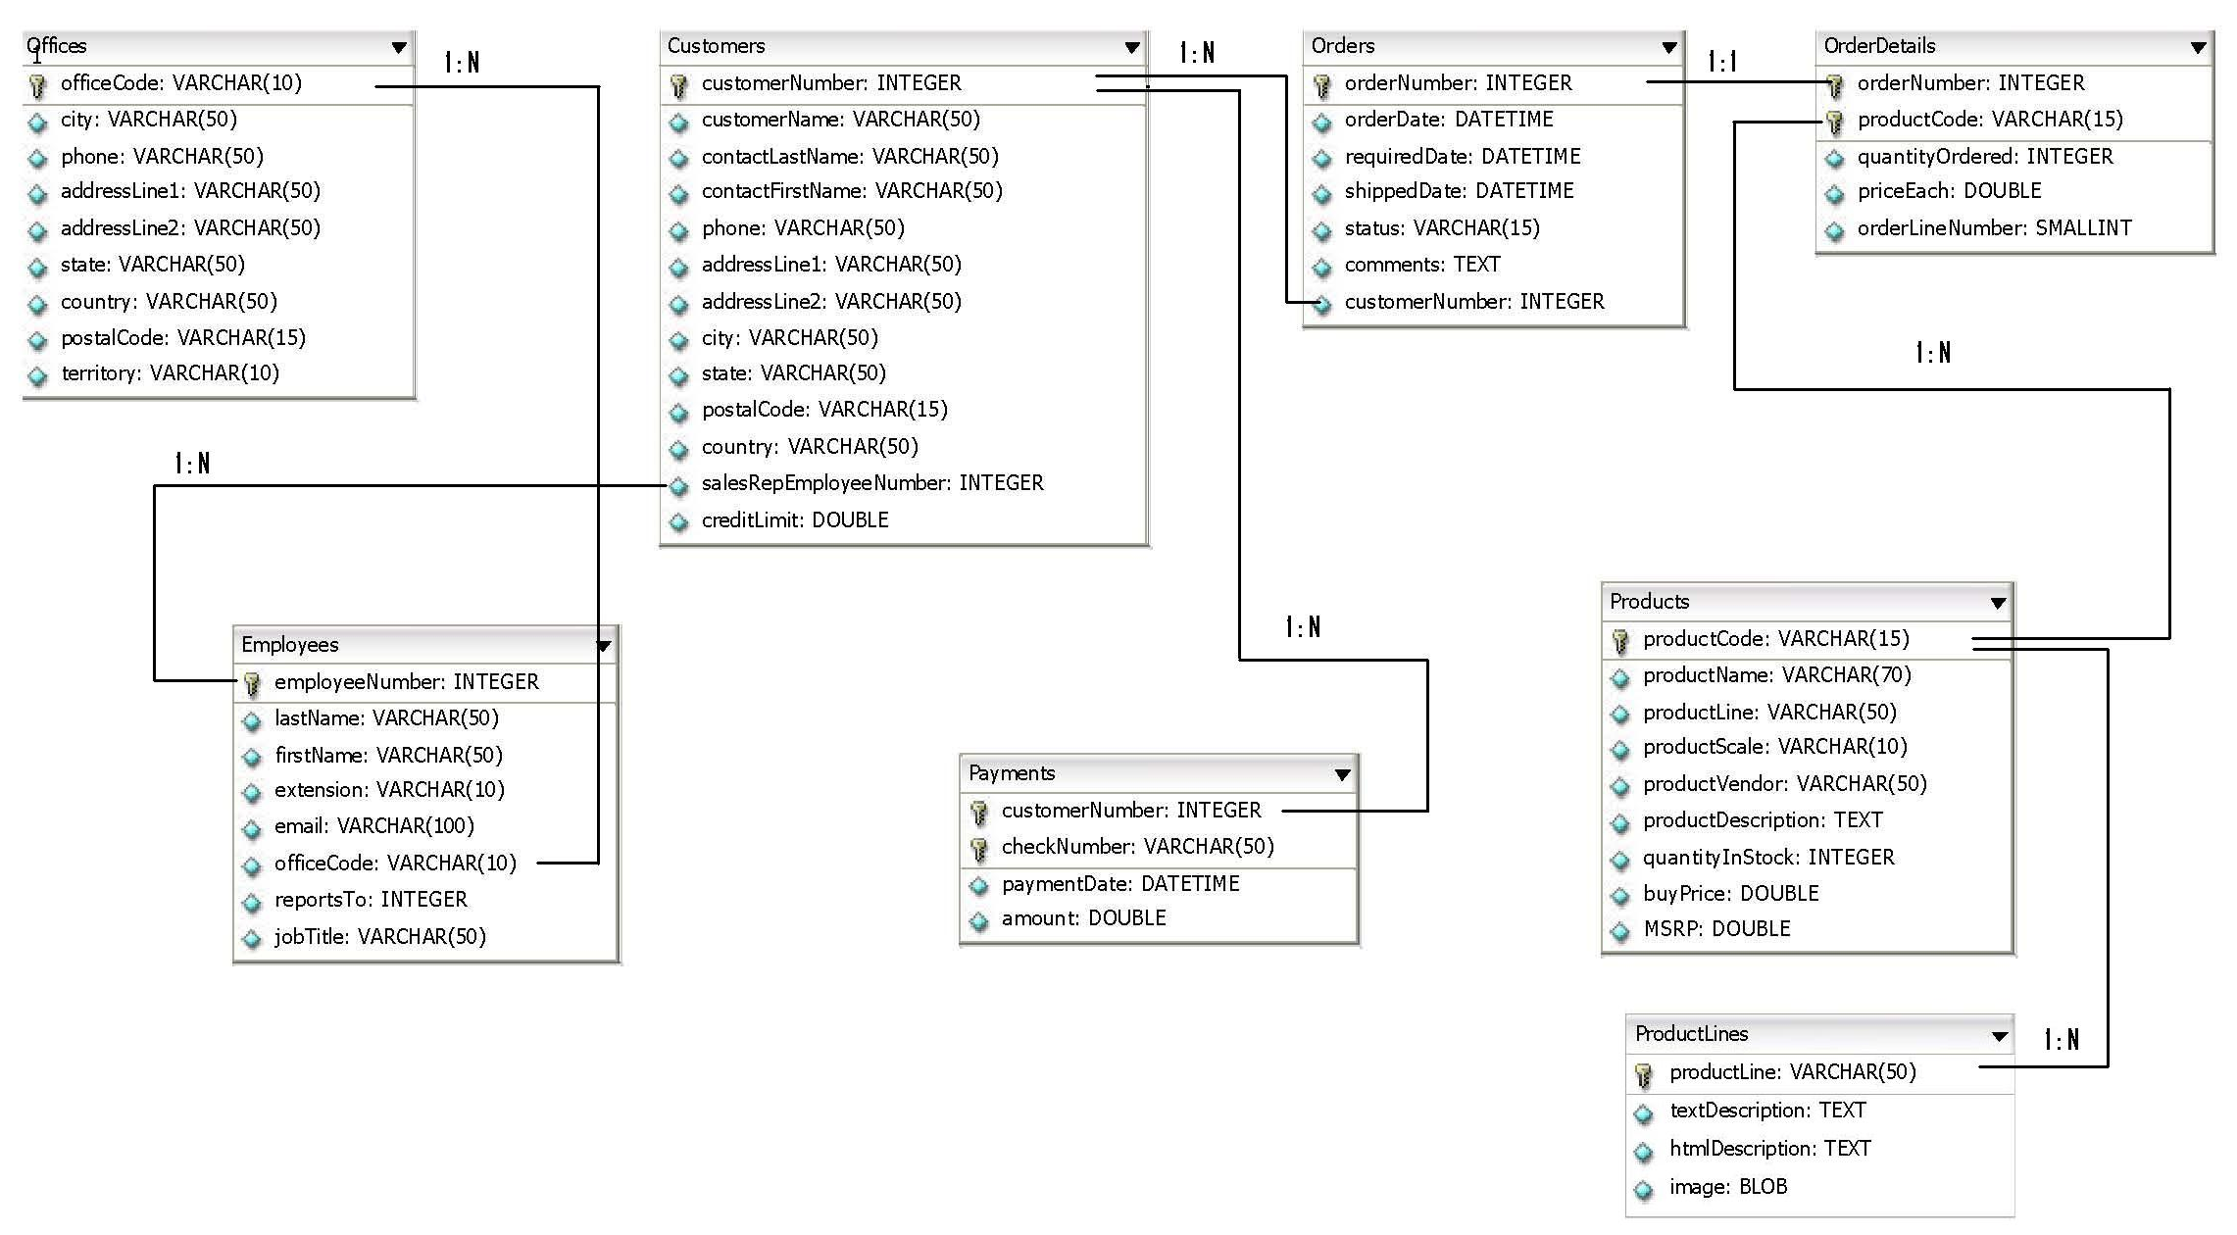
Schema diagram

Slide 7

Scenario
Hi! I am Back!
Now that you have created tables with constraints and used different operators, functions and clauses, I would want you to take care of some requirements I have which involve fetching data from more than one tables ...
Lets learn about Joins which will help us meet TIM’s requirements..

Slide 8

Do you Know
What will be the query to SELECT Data from multiple tables
?

Slide 9

Joins
Why JOIN?
SQL joins are used to query data from two or more tables, based on a relationship between certain columns in these tables.
Using JOINS, you can fetch exactly the data you want from any number of tables with just one query, using any search parameter you chose to filter the results.
Different vendors allow varying numbers of tables to join in a single join operation.
For example,
Oracle is unlimited in the number of allowable joins
Microsoft SQL Server allows up to 256 tables in a join operation

Slide 10
Joins Style
Which JOIN Style?
SQL joins can be written using either of below two styles.
Theta Style
ANSI Style (Preferred by Industry)
Theta Style
In non-ANSI standard implementation, the join operation is performed in the WHERE clause in the query.
This join method is known as the theta style.
In the FROM clause, tables are listed as if with Cartesian products.
The WHERE clause specifies how the join should take place.
This is considered to be the "old" style.
It is somewhat confusing to read.

Slide 11
Joins Style
Which JOIN Style?
Theta Style Cont..
Syntax :
Where:
ColumnName1 in TableName1 is usually that table's Primary Key
ColumnName2 in TableName2 is a Foreign Key in that table
ColumnName1 and ColumnName2 must have the same Data Type & for certain data types, the same size.
SELECT <ColumnName1>,<ColumnName2>,<ColumnNameN>
FROM<TableName1>,<TableName2>
WHERE<TableName1>.<ColumnName1>=<TableName2>.<ColumnName2>
AND<Condition>
ORDER BY<ColumnName1>,<ColumnName2>,<ColumnNameN>

Slide 12
Joins Style
Which JOIN Style?
ANSI Style:
In the ANSI SQL-92 standards, joins are performed by incorporating JOIN clause in the query.
This join method is known as ANSI style
Syntax :
Joins in the ANSI style are more readable than those in theta style, since the query itself clearly indicates, which table is on the left in a LEFT JOIN & which table is on the right in a RIGHT JOIN which we will see soon.
There are two variations of ANSI Style as JOIN ... ON (Preferred by Industry) & JOIN … USING which are covered in next example.
SELECT <ColumnName1>,<ColumnName2>,<ColumnNameN>
FROM<TableName1><JOIN TYPE><TableName2>
ON <TableName1>.<ColumnName1>=<TableName2>.<ColumnName2>
WHERE<Condition>
ORDER BY<ColumnName1>,<ColumnName2>,<ColumnNameN>

Slide 13
Joins Style
Which JOIN Style?
ANSI Style: JOIN ... ON
With JOIN ... ON, one separates the join terms from the filtering terms.
Example:
SELECT o.city, o.country, e.jobtitle
FROM offices o INNER JOIN employees e
ON (o.officecode=e.officecode)
WHERE o.country LIKE ‘%USA%’;
It is quite clear now what belongs to what.
Note: The parenthesis are not strictly required in the ON clause.

Slide 14
Joins Style
ANSI Style: JOIN ... USING
Is the special case where we join tables on columns of the same name, we can make a shortcut and use USING.
Rewriting the previous example:
SELECT o.city, o.country, e.jobtitle
FROM offices o INNER JOIN employees e
USING (officecode)
WHERE o.country LIKE ‘%USA%’;
This time the parenthesis are required
Note: This ANSI syntax is supported only by: MySQL, Oracle & DB2 databases.

Slide 15
Scenario
Ok!
I would want you to stick to JOIN ..ON syntax for all my requirements!
Lets use ANSI JOIN …ON syntax in all the examples..

Slide 16
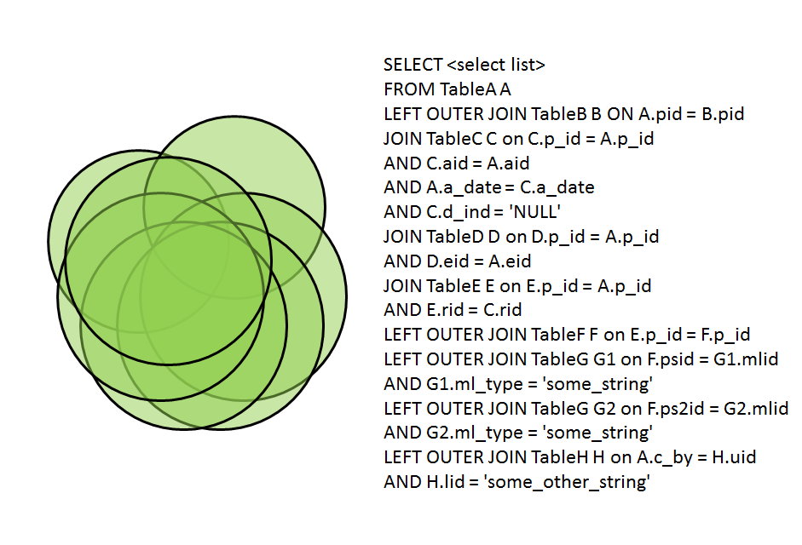

Joins Types
JOIN Types
We will be looking at following different types of JOINS which are supported by almost all database vendors in market
CROSS JOIN
INNER JOIN
» EQUI-JOIN
» NATURAL JOIN
OUTER JOIN
» LEFT OUTER JOIN
» RIGHT OUTER JOIN
» FULL OUTER JOIN
SELF JOIN
WHAT WERE THEY THINKING
ANSI standard SQL specifies four types of JOIN: INNER, OUTER, LEFT, and RIGHT.

Slide 17
Scenario
I want to display all combinations of country and job titles. Use: offices and employees tables.
Lets use CROSS JOIN to meet TIM’s requirement..

Slide 18
Joins Types
CROSS JOIN
CROSS JOIN returns the Cartesian product of rows from tables in the join.
In other words, it will produce rows which combine each row from the first table with each row from the second table
CROSS JOIN can be used in situations where the various combinations of two /more table records is needed
The cross join does not apply any predicate to filter records from the joined table.
Programmers can further filter the results of a cross join by using a WHERE clause.
ANSI Style:
SELECT o.country, e.jobtitle
FROM offices o CROSS JOIN employees e;
Rule :
If two table t1 & t2 having columns p & r, rows n & m respectively are exhibiting
CROSS JOIN then the result of query will produce p+r columns & n*m tuples.

Slide 19
Joins Types
INNER JOIN
An inner join is the most common join operation used in applications and can be regarded as the default join-type.
Inner join creates a new result table by combining column values of two tables (A and B) based upon the join-predicate.
The query compares each row of A with each row of B to find all pairs of rows which satisfy the join-predicate.
When the join-predicate is satisfied, column values for each matched pair of rows of A and B are combined into a result row.
The result of the join can be defined as the outcome of first taking the Cartesian product (or Cross join) of all records in the tables (combining every record in table A with every record in table B)—then return all records which satisfy the join predicate.

Slide 20
Scenario
I want to display all rows from selected columns in offices and employees tables where ever there is a match between officecodes.. Help me do that!
Lets use INNER JOIN to meet TIM’s requirement..

Slide 21
Joins Types
INNER JOIN Cont..
ANSI Style:
SELECT o.city, o.country, e.jobtitle
FROM offices o INNER JOIN employees e
ON o.officecode=e.officecode;
The query given in the example above will join the offices and employees tables using the officecode column of both tables.
The queries return all rows from the offices and employees tables where there is a matching officecode value in both the tables.
Where the officecode does not match, no result row is generated.

Slide 22
Joins Types
INNER JOIN Cont..
Programmers should take special care when joining tables on columns that can contain NULL values, since NULL will never match any other value (not even NULL itself), unless the join condition explicitly uses the IS NULL or IS NOT NULL predicates.
INNER JOIN can be further classified into following types which will be discussed in next slide
EQUI-JOIN &
NATURAL JOIN

Slide 23
Joins Types
EQUI-JOIN
An equi-join is a specific type of comparator-based join, that uses only equality (=) comparisons in the join-predicate.
Using other comparison operators (such as <,>,<=,>=) disqualifies a join as an equi-join. The query shown before has already provided an example of an equi-join.
ANSI Style:
SELECT o.city, o.country, e.jobtitle
FROM offices o INNER JOIN employees e
ON o.officecode=e.officecode;

Slide 24
Joins Types
NATURAL JOIN
A natural join is a type of equi-join where the join predicate arises implicitly by comparing all columns in both tables that have the same column-names in the joined tables.
The resulting joined table contains only one column for each pair of equally named columns.
Most experts agree that NATURAL JOINs are dangerous and therefore strongly discourage their use.
The danger comes from inadvertently adding a new column, named the same as another column in the other table.
An existing natural join might then "naturally" use the new column for comparisons, making comparisons/matches using different criteria (from different columns) than before.
Thus an existing query could produce different results, even though the data in the tables have not been changed, but only augmented.

Slide 25
Scenario
I want to display a table after implicitly joining orders and orderdetails such that it contains only one ordernumber column..Help me do that!
Lets use NATURAL JOIN to meet TIM’s requirement..

Slide 26
Joins Types
NATURAL JOIN Cont..
ANSI Style:
SELECT * FROM orders NATURAL JOIN orderdetails;
As with the explicit USING clause, only one ordernumber column occurs in the joined table, without qualifier table name.
Rule :
In case of USING clause & NATURAL JOIN only one copy of join key column occurs
in the result, with no qualifier.

Slide 27
Joins Types
OUTER JOIN
An outer join does not require each record in the two joined tables to have a matching record.
The joined table retains each record—even if no other matching record exists.
Outer joins subdivide further into
LEFT OUTER JOIN or LEFT JOIN ,
RIGHT OUTER JOIN or RIGHT JOIN ,
FULL OUTER JOIN
depending on which table's rows are retained (left, right, or both).
(In this case left and right refer to the two sides of the JOIN keyword.)
No implicit join-notation for outer joins exists in standard SQL.(Which implies you must use either LEFT /RIGHT/FULL . Just OUTER JOIN will not work.)

Slide 28
Scenario
I want to display selected columns from customers and payments tables such that all rows from customers table are displayed irrespective of whether there is a match in payments or not.
Lets use LEFT JOIN to meet TIM’s requirement..

Slide 29
Joins Types
LEFT OUTER JOIN
The result of a left outer join (or simply left join) for table A and B always contains all records of the "left" table (A), even if the join-condition does not find any matching record in the "right" table (B).
This means that if the ON clause matches 0 (zero) records in B (for a given record in A), the join will still return a row in the result (for that record)—but with NULL in each column from B.
A left outer join returns all the values from an inner join plus all values in the left table that do not match to the right table.
ANSI Style:
SELECT c.city, p.checknumber, p. amount
FROM customers c LEFT OUTER JOIN payments p
ON c.customernumber=p.customernumber;

Slide 30
Scenario
I want to display selected columns from customers and payments tables such that all rows from payments table are displayed irrespective of whether there is a match in customers or not.
Lets use RIGHT JOIN to meet TIM’s requirement..

Slide 31
Joins Types
RIGHT OUTER JOIN
A right outer join (or right join) closely resembles a left outer join, except with the treatment of the tables reversed.
Every row from the "right" table (B) will appear in the joined table at least once.
If no matching row from the "left" table (A) exists, NULL will appear in columns from A for those records that have no match in B.
A right outer join returns all the values from the right table and matched values from the left table (NULL in case of no matching join predicate).
ANSI Style:
SELECT c.city, p.checknumber, p. amount
FROM customers c RIGHT OUTER JOIN payments p
ON c.customernumber=p.customernumber;

Slide 32
Scenario
Combine the effect of applying both left and right outer joins on
customers and payments tables.
Lets use FULL OUTER JOIN to meet TIM’s requirement..

Slide 33
Joins Types
FULL OUTER JOIN
Conceptually, a full outer join combines the effect of applying both left and right outer joins.
Where records in the FULL OUTER JOINed tables do not match, the result set will have NULL values for every column of the table that lacks a matching row.
For those records that do match, a single row will be produced in the result set (containing fields populated from both tables).
Supported : Microsoft SQL Server, DB2, Oracle 10g, 11g Not Supported : MySQL, Sybase
ANSI Style:
SELECT c.city, p.checknumber, p. amount
FROM customers c FULL OUTER JOIN payments p
ON c.customernumber=p.customernumber;

Slide 34
Joins Types
FULL OUTER JOIN Cont..
Some database systems do not support the full outer join functionality directly, but they can emulate it through the use of an inner join and UNION ALL selects of the "single table rows" from left and right tables respectively.
Example:
SELECT c.city, p.checknumber, p. amount FROM customers c
LEFT JOIN payments p ON c.customernumber=p.customernumber
UNION
SELECT c.city, p.checknumber, p. amount FROM customers c
RIGHT JOIN payments p ON c.customernumber=p.customernumber;

Slide 35
Joins Types
SELF JOIN
A self-join is joining a table to itself.
Use a self-join when you want to create a result set that joins records in a table with other records in the same table.
To list a table two times in the same query, you must provide a table alias for at least one of instance of the table name.
This table alias helps the query processor determine whether columns should present data from the right or left version of the table.
ANSI Style
SELECT a.lastname, a.reportsto, b.firstname, b.reportsto, b.jobtitle
FROM employees a INNER JOIN employees b
ON a.jobtitle =b.jobtitle;

Slide 36
Any Questions?

Slide 37

Hands On
Now we are well versed with join & various types of joins!
Let us help Tim to find answers to his complicated queries for online feedback system.
Please check Hands On document for more details.
Yeah!

Slide 38
Activity
Now we are well versed with commands lets test our understanding using short case study
Case Study Scenario:
This case study is to develop a Course Management System (CMS) for Cognizant Academy. The following are the two use cases for which the database needs to be designed.
Add Course
– To add the course details into the course management system.
Retrieve Course
– Retrieve the courses stored in the system and display it.
The courses to be added will have the following attributes Course Code, Course Name, Number of participants, Course Description, Course Duration, Course start date and Course Type.
Course Management System (CMS) Cognizant Academy
Outcome Assured…

Slide 39
Lend a Hand
Requirement #1: Write a query to fetch student ID, first name, last name and course code for students who have enrolled for course having course_code as 167. Student_Info and student_courses to be queried.
Requirement #2: Write a query to display the discount offerered on the courses along with course descriptions.
Pre-requisite for Requirement #3: Create a student record (student_info_ <employee id>).
NOTE: Do not create any other detail regarding this student in any other table.
Requirement #3: Write a query to fetch first names of the students along with the course codes of the courses they have enrolled in. Note even if the course_code does not exist for a student, the record needs to be fetched.
Get the same output as per the requirement above using :
Left Join
Right Join

Slide 40
Lend a Hand - Solution
Solution #1:
SELECT s.student_id, s.first_name, s.last_name, s.address, c.course_code
FROM student_info INNER JOIN student_course
ON s.student_id = c.student_id WHERE c.course_code = 167;
Solution #2:
SELECT cf.discount, ci.course_description
FROM course_fees cf INNER JOIN course_info ci
ON cf.course_code=ci.course_code;
Solution #3(a):
SELECT si.first_name, sc.course_code
FROM student_info si LEFT JOIN student_courses sc
ON si.student_id = sc.student_id;
Solution #3(b):
SELECT first_name, course_code
FROM student_courses sc RIGHT JOIN student_info si
ON sc.student_id = si.student_id;

Slide 41
Test Your Understanding
What is use of JOIN & JOIN Style?
What is use of Theta Style?
What is use of ANSI Style: JOIN ... ON & JOIN ... USING?
What is CROSS JOIN?
What is INNER JOIN?
What is EQUI-JOIN?
What is NATURAL JOIN?
What is OUTER JOIN?
What is LEFT OUTER JOIN?
What is RIGHT OUTER JOIN?
What is FULL OUTER JOIN?
What is SELF JOIN?

Slide 42
Summary
We have learnt following
JOIN & JOIN Style
Theta Style
ANSI Style: JOIN ... ON & JOIN ... USING
CROSS JOIN
INNER JOIN
EQUI-JOIN
NATURAL JOIN
OUTER JOIN
LEFT OUTER JOIN
RIGHT OUTER JOIN
FULL OUTER JOIN
SELF JOIN

Slide 43
Source
Website:
http://en.wikipedia.org/wiki/Join_(SQL)
Books:
OReilly SQL In NutShell Page No : 37, 144, 145, 146
Oracle for Professionals - Covers Oracle 9i, 10g and 11g W CD By Sharanam Shah, Vaishali Shah Page no:451
Disclaimer: Parts of the content of this course is based on the materials available from the Web sites and books listed above. The materials that can be accessed from linked sites are not maintained by Cognizant Academy and we are not responsible for the contents thereof. All trademarks, service marks, and trade names in this course are the marks of the respective owner(s).

Slide 44
Understanding ANSI SQL
You have successfully completed -
Joins and Their Types

Slide 45
Change Log
Version Number | Changes made
V1.0 | Initial Version
V1.1 | Slide No. | Changed By | Effective Date | Changes Effected

